Slide 1

Lightweight and Performance Driven Ticketing System
Gabe Harman
Jim Farlow

Slide 2
The Problem We Aimed to Solve
Available Ticketing Systems are too bloated and/or not easily customizable
Our Goal was to create a ticketing system that is easy to use and understand while still being lightweight and customizable
We also aimed for the webpage to be mobile friendly
Still have security expectations such as group and user level permissions

Slide 3
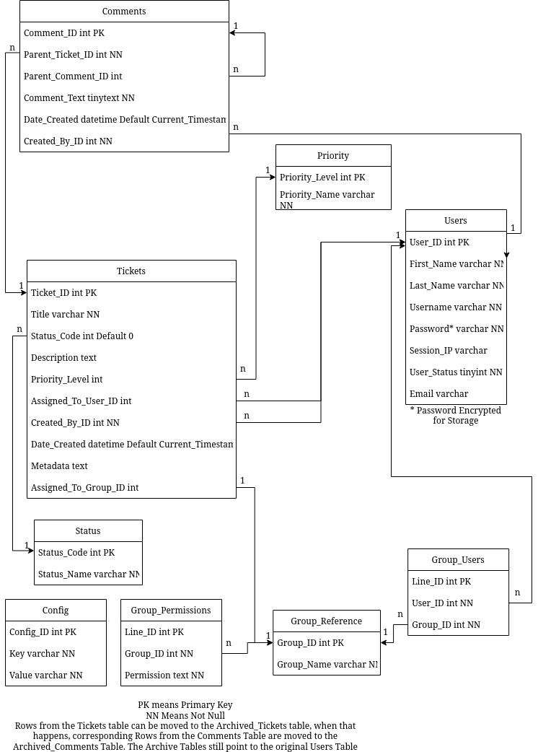
Our Implementation
We created a MySQL database to hold persistent data
We used an Apache Server running on Ubuntu to host our webpage which was made in PHP
Our application was successfully deployed and tested on a Raspberry Pi 4th generation

Slide 4
Future Work and Reflections
Future Work
Include more defaults in tables like Statuses, Priorities, and Groups
Implement an API
Unify UI Design
Create a theme option for users
Implement external authentication support
Reflections
This turned out to be a great application for small to medium sized groups that require ticket support
We achieved our goal of keeping the program lightweight and responsive proven by the application working on a raspberry pi

